Slide 1

VOCATIONAL TRAINING PRESENTATION
On
Social Networks Advertisement
Presented by:
DHEERAJ MISHRA
CSE (DS)- Semester (5th)
300012821013

Slide 2
INDEX
Introduction- About project
Design- Model working diagram
Analysis- about project requirements
Snapshots
Lessons Learned
Conclusion

Slide 3
Introduction- About project
Social Network Advertisement has become an indispensable element of modern marketing, allowing businesses to connect with a diverse and expansive audience.
However, amidst the vastness of social media platforms, the challenge lies in targeting the right audience effectively. This project addresses this challenge through the utilization of Support Vector Machine (SVM), a powerful machine learning algorithm.
In today's dynamic digital landscape, businesses face difficulties in pinpointing their target audience on social media. This project aims to leverage SVM to enhance the precision and efficiency of social network advertising.
SVM's ability to handle high-dimensional data and classification tasks positions it as an ideal solution for analyzing user behavior on social platforms and optimizing ad targeting.

Slide 4
Design- Model working diagram
Data Collection from CSV Files:
The project begins by sourcing relevant data from CSV files containing information such as user id, gender, age and estimated Salary.
2.Data Preprocessing Steps:
The CSV data undergoes meticulous preprocessing, addressing missing values, encoding categorical variables, and scaling numerical features to prepare it for SVM analysis.
3.Feature Selection from CSV Data:
Feature selection involves identifying and choosing the most pertinent features from the CSV dataset, ensuring they contribute meaningfully to the SVM model's classification accuracy.
4.SVM Model Training with CSV Data:
The SVM model is trained using the preprocessed CSV data, learning to classify users based on their characteristics and behaviors extracted from the CSV files.

Slide 5
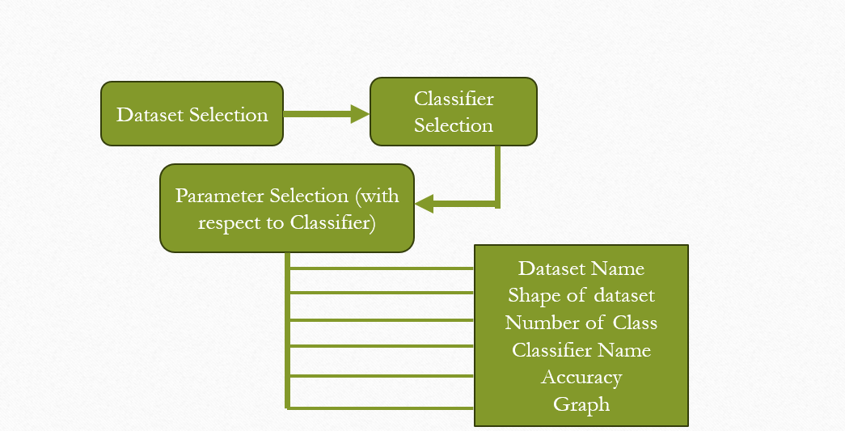
Model working diagram
Fig 1.1 Step by step models working

Slide 6
Analysis- about project requirements
CSV Data Integration:
Integration of CSV data involves aligning the data format with the project's requirements, ensuring that the information stored in CSV files seamlessly fits into the SVM model.
Computational Resources for CSV Handling:
Considering the potentially large CSV datasets, computational resources are allocated to efficiently handle and process the data, ensuring the model's scalability.
CSV-Compatible Software and Tools:
Software and tools chosen for the project are selected based on their compatibility with CSV data, facilitating smooth preprocessing, model training, and evaluation processes.
Required Library:
Pandas , Matplotlib , Scikit-Learn , NumPy.
Algorithm or classifier used:
Support Vector Machine (SVM) is a machine learning algorithm that classifies data points by finding the optimal hyperplane to separate different classes, maximizing the margin between them in a high-dimensional space. It is particularly effective for both linear and non-linear classification tasks.

Slide 7
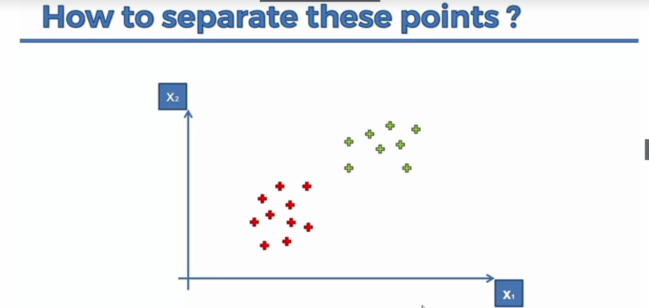
About SVM

Slide 8
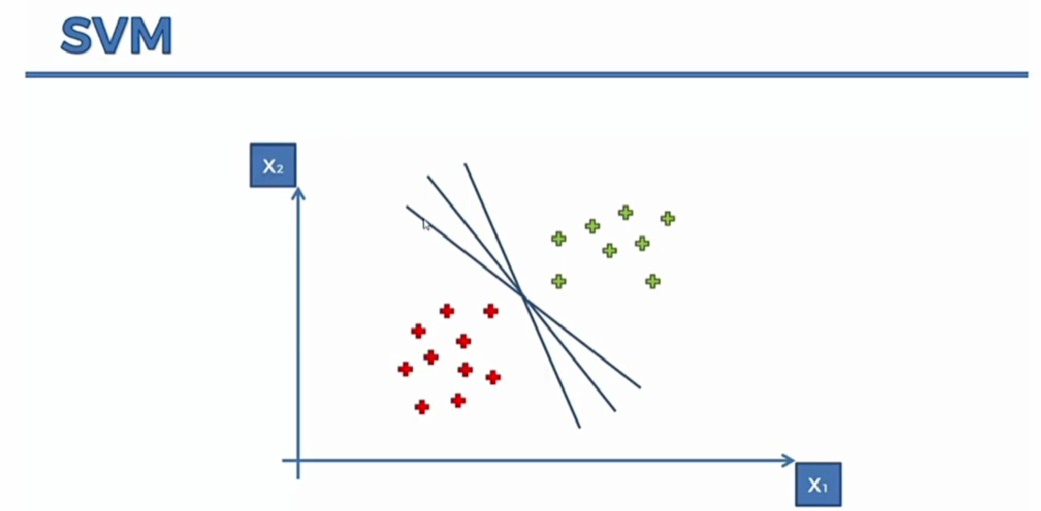

Slide 9
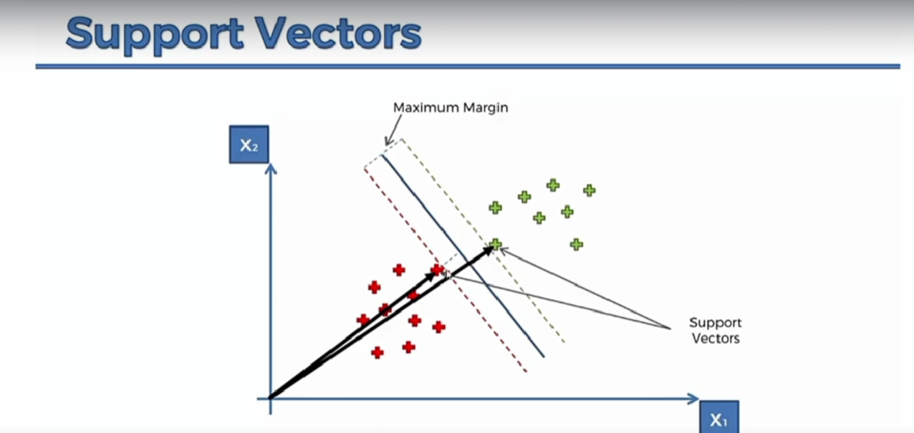
Fig 1.2 Support Vector Machine

Slide 10
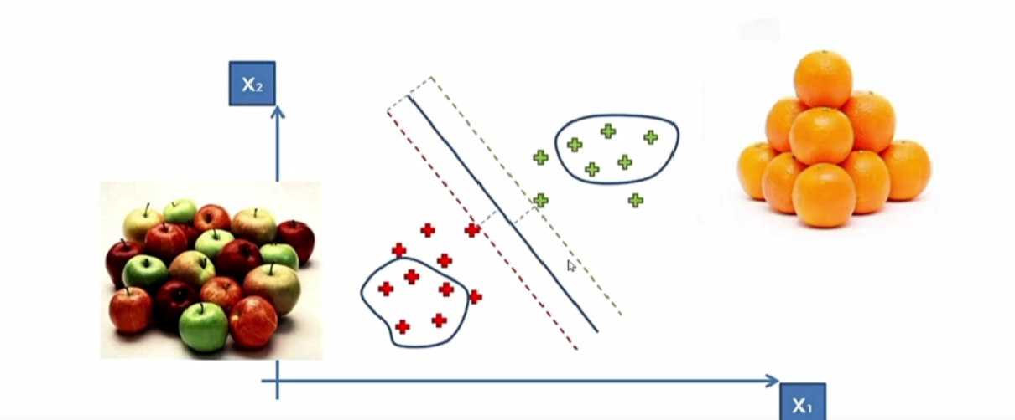
Example:-

Slide 11
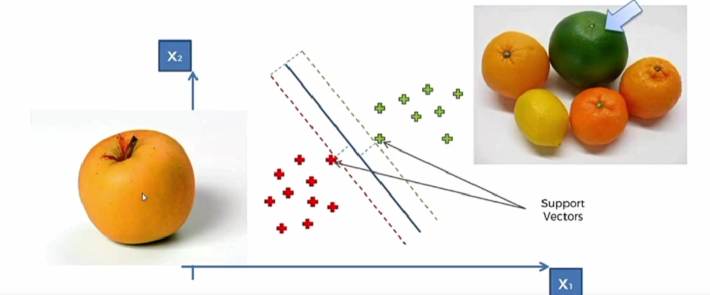

Slide 12
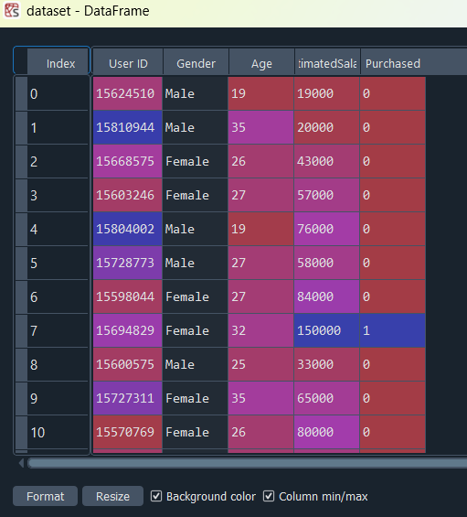
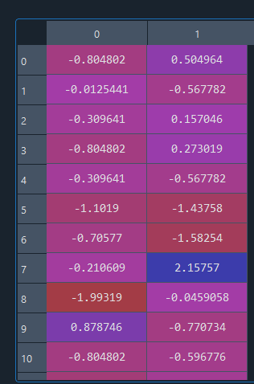
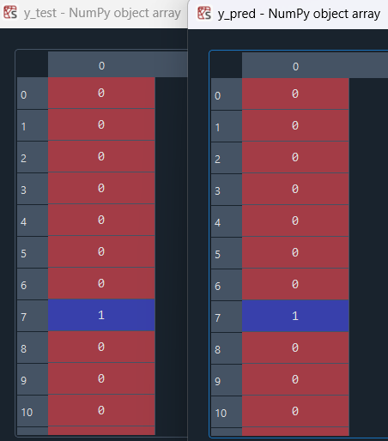
Snapshots
Testing dataset
Dataset
Prediction

Slide 13
Lessons Learned
Quality of CSV Data:
The success of the SVM model hinges on the quality of the CSV data, emphasizing the importance of thorough data quality checks and cleaning processes.
CSV Feature Engineering:
Feature engineering with CSV data proves pivotal, prompting the exploration of various feature combinations to enhance the SVM model's ability to discern patterns.
Dynamic Adaptation to CSV Changes:
Acknowledging the dynamic nature of social media, the project underscores the necessity for continuous evaluation and adaptation to changes in CSV data due to evolving user behavior or platform updates.
Scalability with CSV-Based Models:
Scalability considerations revolve around the ability of the project to handle growing CSV datasets, accommodating increased data volumes and user interactions while maintaining the SVM model's efficiency.

Slide 14
Conclusion
High Accuracy Achievement: Achieving a 90% correct prediction rate using Support Vector Machine (SVM) underscores the efficacy of the algorithm in accurately classifying and discerning patterns within the dataset.
Robust Model Performance: The consistent high accuracy reflects the robustness of the SVM model, demonstrating its ability to handle complex data and make precise predictions across various scenarios.
Data-Driven Decision Making: The success in reaching a 90% accuracy highlights the value of leveraging SVM for data-driven decision-making in social network advertising, paving the way for more informed and strategic marketing efforts.

Slide 15
Thank You

